Slide 1
ECML Conference
LEARNING THROUGH LANGUAGES
10 - 11 Dec 2015
MoreDOTS/ICT-REV
Martina Emke
Language for Work
Alexander Braddell

Slide 2
  Introductions +
  Who you are, which country you are from
  +
  What you want to take away from this workshop
  e.g. understanding of the two projects

Slide 3
  Workshop agenda
  Project presentations
    MoreDOTS/ICT-REV
    Language for Work
  Discussion

Slide 4
  While we tell you about the projects…
  …Please consider two questions
  1. How do these projects support practitioners in your country?
  2. What themes / approaches do the two projects share in common?

Slide 5




Project 1: 2008 – 2011
Product: Moodle workspace, introduced in Graz, Sept 2011
New ECML Programme: 2012 – 2015 (Learning through languages)
New series of projects
Follow-up projects of DOTS
  More DOTS 2012 – 2013
  Targeted Support 2012 – 2013

Slide 6
USE OF ICT IN SUPPORT OF LANGUAGE TEACHING AND LEARNING
INNOVATIVE METHODOLOGIES AND ASSESSMENT IN LANGUAGE
LEARNING
based on an 8-year series of pan-European workshops a sound concept for professional development workshops has been developed
workshops for language teaching professionals (teachers, teacher educators, multipliers) are now available under the ECML’s Teaching & Consultancy programme
core are the DOTS / ICT-REV Moodle workspace and the ICT-REV inventory
European Centre for Modern Languages and European Commission cooperation on Innovative Methodologies and Assessment In Language Learning

Slide 7
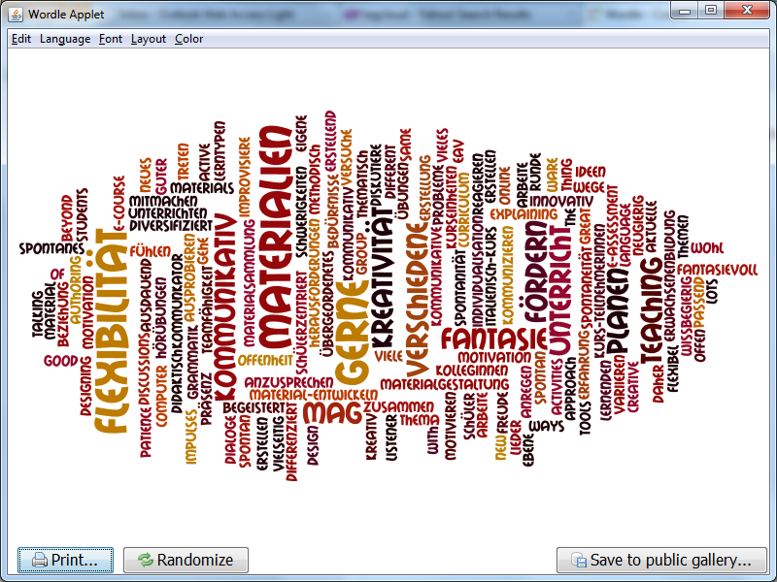
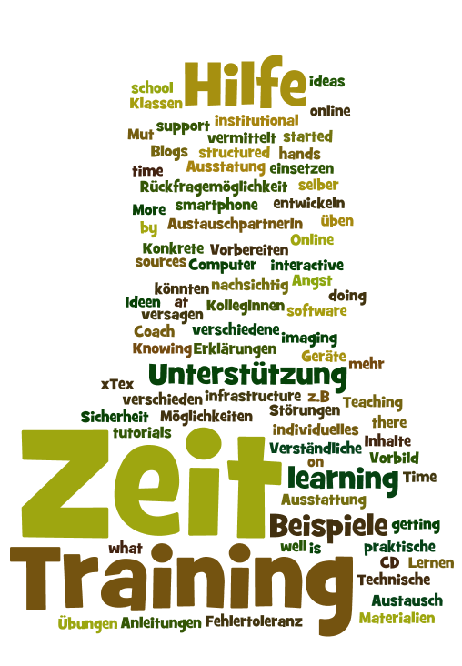
Teachers’ strengths and needs identified
Tagclouds generated
with Wordle
Notes:
I could imagine saying something like: we start with identifying teacher strengths and needs – and here are some examples from a workshop. Comment on what they are. Therefore, we created a workspace (next slide) with bitesize training materials.
Also mention: all languages welcome!

Slide 8
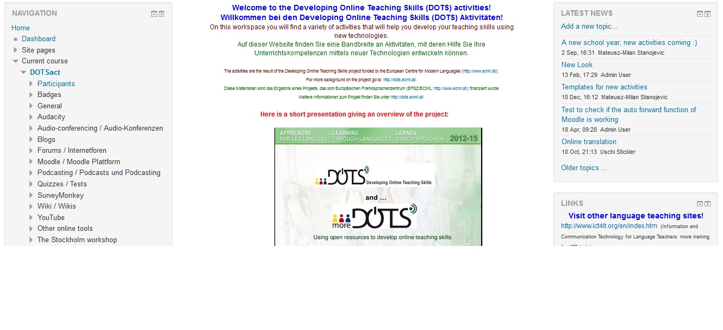
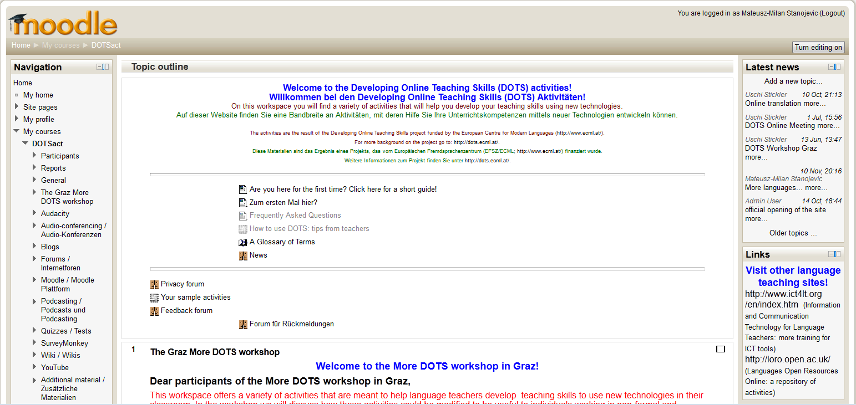
DOTS / ICT-REV workspace http://moodle.dots.ecml.at/

Slide 9
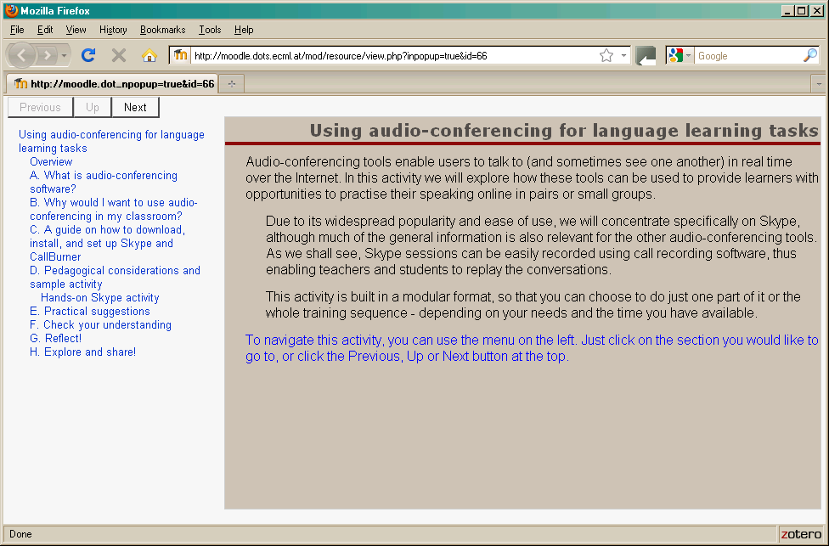
Training module
<<insert screenshot of DOTSMoodle page:
Detail of one LO with all its parts and path through the activity>>

Slide 10
Personal development plan
Action Plan
Follow through
Obtain feedback
Analyse feedback
(Re)design
Notes:
This is a personal development plan that can be used by individuals (voluntary) or in institutional or CoP-based professional development.

Slide 11

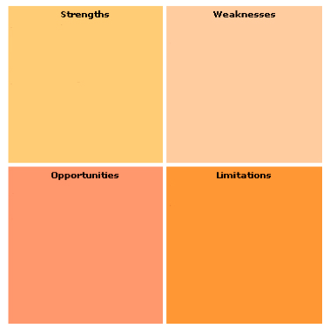
Questions to reflect upon your strengths
What are your advantages?
What do you do well?
What do other people see as your strengths?
Questions to reflect upon your weaknesses
What could you improve?
What do you do badly?
What should you avoid?
Questions to reflect upon your limitations
What obstacles do you face?
Are the required specifications for your job changing?
Is changing technology threatening your teaching style?
Questions to reflect upon your opportunities
What are the opportunities you face?
What current trends can you take advantage of?
Notes:
The notion of sharing SWOLs with others during the workshop to create synergies – the sharing aspect as important.

Slide 12
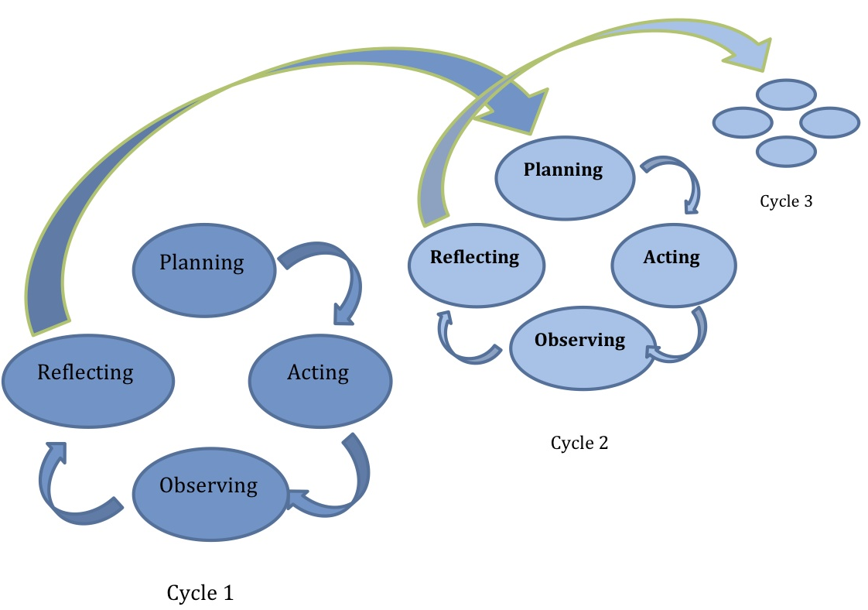
Reflective practice: the action research spiral
Chapter 9: Approaches to research and implications for pedagogy. In Hampel, R. and Stickler, U. (eds.) Developing online language teaching skills: pedagogy, practice and reflexion. Palgrave Macmillan (2015)
Notes:
From: Hampel, Regine

Slide 13
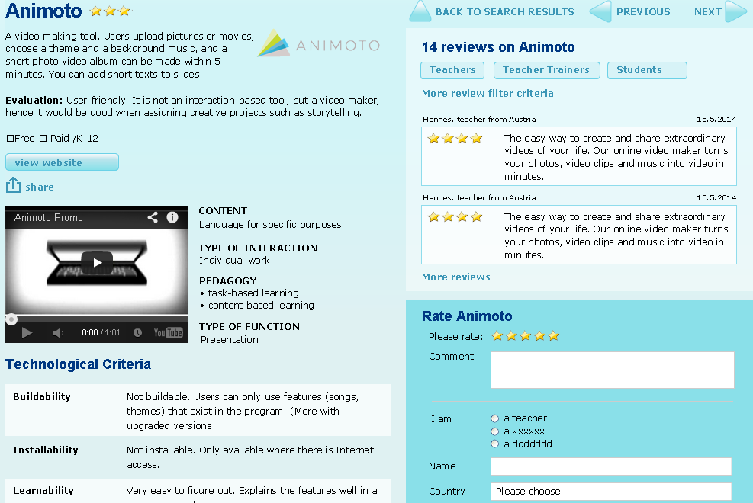
CoP: the ICT-REV inventory
Notes:
The community of practice instigated by the f2f workshops, national developments
Supra-national developments: the role of the ECML, + ICT-REV (inventory)

Slide 14

Language for Work project
European learning network for professionals supporting work-related second language development
Project team
Matilde Grünhage-Monetti (De) ex Deutsches Institut für Erwachsenenbildung
Florence Mourlhon-Dallies (Fr) Université René Descartes Paris V Sorbonne
María Teresa Hernández García (Es) Comunidad de Madrid
Alexander Braddell (UK) OSEC CIC Ltd

Slide 15

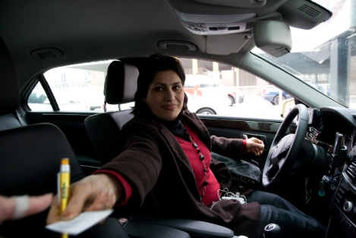
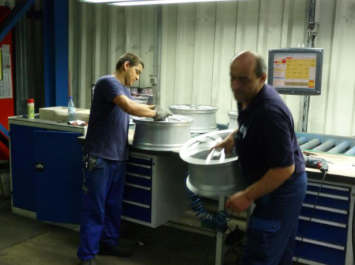
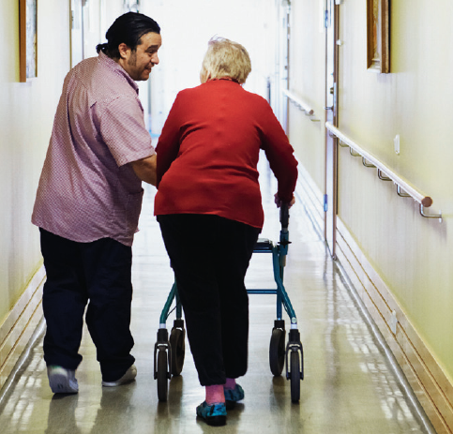
Snapshot 1: Four typical Europeans
Ms Bahmani in her taxi
Mr Kaminsky and Mr Cakir producing car parts
Mr Leonal Vasquez caring for the elderly
What do they have in common?
They are all adult migrants who learned the
language they use at work after
moving to the country where they now live

Slide 16
Snapshot 2: EU 27 states, Jan 2013
20.4 million citizens of non-member states living in EU-27 states
33.5 million people born outside of EU-27 living in EU-27 states
13.7 million EU-27 citizens living as foreign nationals in a different EU-27 state
17.3 million EU-27 citizens living in a different EU-27 state
Source: Eurostat Migration and migrant population statistics (http://ec.europa.eu/eurostat/statistics-explained/index.php/Migration_and_migrant_population_statistics#Migration_flows)

Slide 17
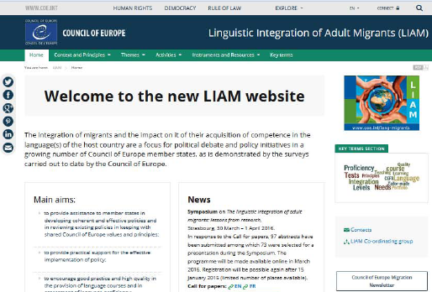
Linguistic integration of adult
migrants (LIAM)
Council of Europe project, working group
Help member states to develop inclusive language policies based on CoE values (human rights, democracy, rule of law)
http://www.coe.int/en/web/lang-migrants
An issue with some history…
e.g. D.A. Wilkins (1973), The Language Needs of Adult Immigrants.
Strasbourg: Council of Europe

Slide 18
Work-related L2 learning?
Integration of migrants essential for society
Work central to migrant integration
Communication central to modern work practices
Ability to communicate effectively at work crucial for migrants, employers, wider society
Work-related language learning matters!

Slide 19
Work-related L2 learning
Complex, boundary crossing
Work, migration, intercultural communication, social policy, learning, language, literacy, linguistics, labour market, people management…etc.
Range of contexts
Pre-employment L2 learning for immigrants, also emigrants
L2 learning in vocational schools
Work-related learning in integration courses
L2 learning for specific occupational areas, qualifications
Workplace L2 learning
Multi-dimensional, many faceted – but connected

Slide 20
Language for Work (LfW) project
    Aim
    Network practitioners across Europe
Rationale
Work-related L2 learning = emerging field
Common concerns across Europe, diverse responses
Network to share practice, help shape policy, enable more effective local responses
Objectives
Three consultative meetings for practitioners to establish network
Development of website to operationalise network

Slide 21
Consultative meetings
2012 20 specialists from 12 European countries
Guest speaker: Dr Knud Illeris (Denmark)
2013 26 specialists from 14 European countries
Guest speaker: Dr Lorna Unwin (UK)
2015 46 specialists from 32 European countries
Guest speaker: Dr Laurent Filliettaz (Switzerland)
Specialist included civil servants, researchers, learning providers, trade unionists, educational publishers
Each event attracted self-funding participants

Slide 22
Meeting focus
Would a network be helpful?
How should it function?
What contribution should it aim to make?
Policy
?
Priorities
Research
Practice

Slide 23
Meeting outcomes
Demand for network? Yes
Aims ?
Raise awareness of LfW, enable sharing of experience and resources (to develop expertise)
Objectives?
Lobbying, advocacy, awareness raising, promotion of LfW at national and European levels
Development of theoretical/conceptual models, practice models, quality frameworks
Provision of expertise and resources
Provision of networking, professional development opportunities

Slide 24
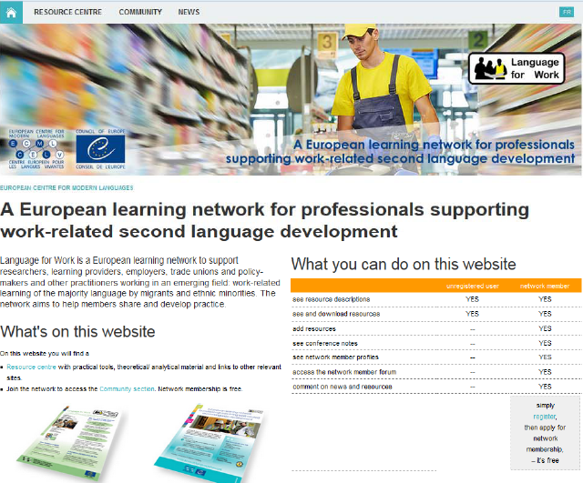
Website
  Resource centre: Practical + theoretical/analytical resources
  Community section to support active networking
  >100 registered
  users from 32
  countries
  40 network
  members in
  20 countries

Slide 25

Project outcomes
Network established, growing
Website up-and-running
2016-19 ECML programme
Language for Work – tools for professional development

Slide 26
  With the person sitting next to you…
  Share your thoughts regarding the two questions: 1. How do these projects support practitioners in your country?
  2. What themes / approaches do the two projects share in common?
  Then…
  3. Document your thoughts on the Padlet board and / or feed them into the plenary discussion.

Slide 27
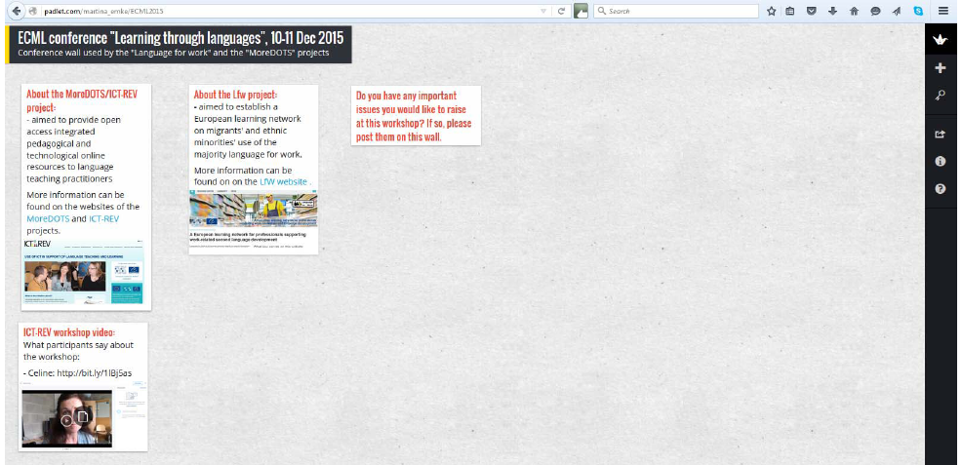
  Padlet board
  http://padlet.com/martina_emke/ECML2015
To post a note, just double-click anywhere on this grey area

Slide 28
  Thank you…
  …and goodbye!

